Slide 2
Software Defined Networks CYB 301 SDN Architecture
Egena Onu, PhD.
Computer Science Department,
Bingham University.

Slide 3
Recall
Control
Program
Control
Program
Control
Program
Global Network Map
Control Plane
Control
Packet
Forwarding
Control
Packet
Forwarding
Control
Control
Packet
Forwarding
Packet
Forwarding
Control
Packet
Forwarding
Notes:
Talk about forwarding & control planes

Slide 4
SDN Architecture
SDN architecture is the fundamental basis of the concept of SDN.
The architecture consists of different components with specialised responsibilities which they perform in the network.
These components include:
Network Devices (Data Plane)
SDN Controller (Control Plane)
Southbound Interface (SBI)
Northbound Interface (NBI)
Application and Services (Application Plane)
Notes:
The Network Operating System (NOS) is also contained in the controller.

Slide 5
SDN Planes
A network plane is an abstraction of the integral components that describe the roles of the components in the transmission of data.
In general telecommunications context, these planes include:
Control Plane
Data Plane
Management Plane

Slide 6
Data Plane
The data plane consists of the various network elements (NE), both physical and virtual.
The data plane incorporates the resources that deal directly with users’ traffic, along with the necessary supporting resources to ensure proper virtualisation, connectivity, security, availability and quality.
Data Plane
Packet Forwarding
Packet Forwarding
Packet Forwarding

Slide 7
Data Plane
The NE resources block comprises:
Data sources
Data sinks
Forwarding and/or traffic processing engines
Virtualiser.
The function of the virtualiser is to abstract the resources to the SDN controller and enforce policy.

Slide 8
Data Plane
The NE resources block comprises:
Data sources
Data sinks
Forwarding and/or traffic processing engines
Virtualiser.
The function of the virtualiser is to abstract the resources to the SDN controller and enforce policy.
Data Plane
NE≥1
Coordinator
Agent (≥1)
Master
RDB
NE resources

Slide 9
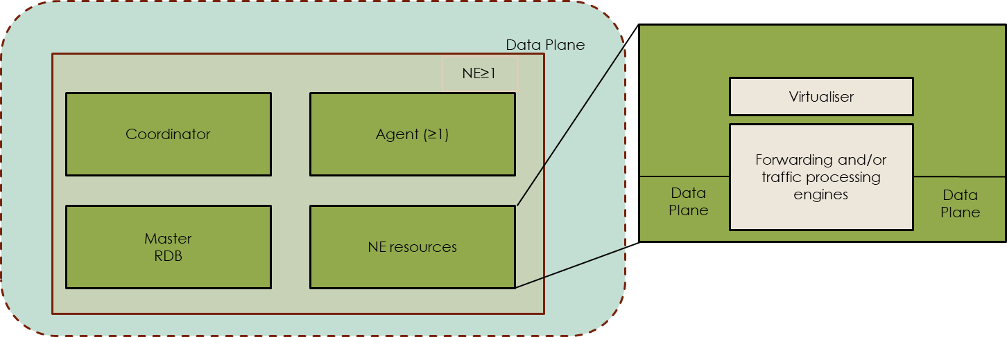
Data Plane
The NE resources block comprises:
Data sources
Data sinks
Forwarding and/or traffic processing engines
Virtualiser.
The function of the virtualiser is to abstract the resources to the SDN controller and enforce policy.

Slide 10
Data Plane
Software-defined networking concerns itself with traffic forwarding and traffic processing functions such as:
QoS
Filtering
Monitoring
Tapping.
Traffic may enter or leave the SDN data plane via physical or logical ports, and may be directed into or out of forwarding or processing functions.
Traffic processing might be exemplified by an OAM engine, an encryption function, or a virtualized network function.
Control of traffic forwarding or processing functions may be performed by an SDN controller or by separate mechanisms, possibly orchestrated in conjunction with the given SDN controller.

Slide 11
Data Plane
The master resource data base (RDB) is the conceptual repository of all resource information known to the network element.
The data plane implements forwarding decisions made in the controller plane. In principle, it does not make autonomous forwarding decisions.
The data plane agent is the entity that executes the SDN controller’s instructions in the data plane.
The data plane coordinator is the entity by which management allocates data plane resources to various client agents and establishes policy to govern their use.
Agents and coordinators serve the same purpose in every plane of the architecture.
Notes:
However, the controller plane may configure the data plane to respond autonomously to events such as network failures or to support functions delivered by, for example, LLDP, STP, BFD, or ICMP.
At the lowest layer of recursion, data plane resources are physical entities (including e.g., soft switches). At higher levels of abstraction, however, data plane resources need not be physical (e.g., virtual NEs). As with the other planes, the SDN architecture operates on an abstract model of the data plane, and as long as the functions advertised by the model are correctly executed, the architecture is blind to the difference.
Management chooses which resources in which NEs are to be controlled by a given SDN controller. These resources are represented as a set of virtual NEs (VNEs), interconnected to form subnetworks. A VNE may itself be a subnetwork via successive abstraction.
The architecture imposes no restrictions on the technology of the data plane. The SDN controller may be used to program data planes implemented in existing technologies, such as DWDM, OTN, Ethernet, IP, etc., or in new data plane technologies that may evolve.

Slide 12
SDN Controller (Control Plane)
SDN Controller is the Center of the SDN Architecture and the most important one of SDN Architecture Components.
In other words, SDN Controller is the brain of the system. The control of all the data plane devices are done via SDN Controller.
It also controls the Applications at Application Layer.
SDN Controller communicate and control these upper and lower layer with APIs through Interfaces.
Notes:
SDN Controller is the blackbox of SDN

Slide 13
SDN Controller (Control Plane)
SDN Controller is the Center of the SDN Architecture and the most important one of SDN Architecture Components.
In other words, SDN Controller is the brain of the system. The control of all the data plane devices are done via SDN Controller.
It also controls the Applications at Application Layer.
SDN Controller communicate and control these upper and lower layer with APIs through Interfaces.
Control Plane
Network Operating System (NOS)
Southbound APIs
Data Plane
Packet Forwarding
Packet Forwarding
Packet Forwarding

Slide 14
SDN Controller (Control Plane)
Functions and services that are part of a controller’s externally-observable behavior include full visibility of the information model instance under its control.
Additional functions that may be required, depending on circumstances:
Topology knowledge and path computation (the controller may also invoke an external service for these functions)
The creation and maintenance of a further abstracted resource model for its applications, with resources bounded by enforced policy. Resource virtualization and control are potentially recursive.
Notes:
An SDN controller is expected to coordinate a number of interrelated resources, often distributed across a number of subordinate platforms, and sometimes to assure transactional integrity as part of the process.
This is commonly called orchestration.
An orchestrator is sometimes considered to be an SDN controller in its own right, but the reduced scope of a lower level controller does not eliminate the need for the lower level SDN controller to perform orchestration across its own domain of control.

Slide 15
SDN Controller Functional Components
The functional components of the SDN controller include:
Coordinator
Master RDB
SDN Control Logic
Agent
Subject to the logical centralization requirement, an SDN controller may include arbitrary additional functions.

Slide 16
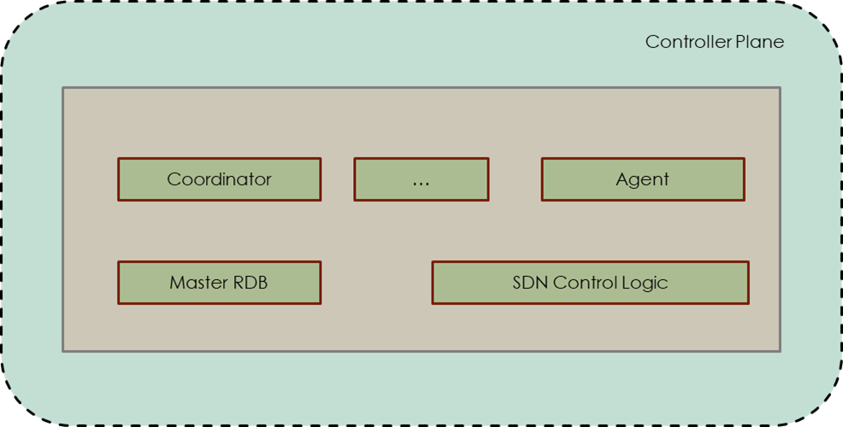
SDN Controller Functional Components
The functional components of the SDN controller include:
Coordinator
Master RDB
SDN Control Logic
Agent
Subject to the logical centralization requirement, an SDN controller may include arbitrary additional functions.

Slide 17
SDN Controller Functional Components
Data Plane Control Function (DPCG)
The DPCF component effectively owns the subordinate resources available to it, and uses them as instructed by the OSS/coordinator or virtualiser(s) that controls them.
These resources take the form of an information model instance accessed through the agent in the subordinate level.
The SDN controller can span multiple (virtual) NEs or even multiple virtual networks. Therefore, the DPCF must include a function that operates on the aggregate. This function is commonly called orchestration.

Slide 18
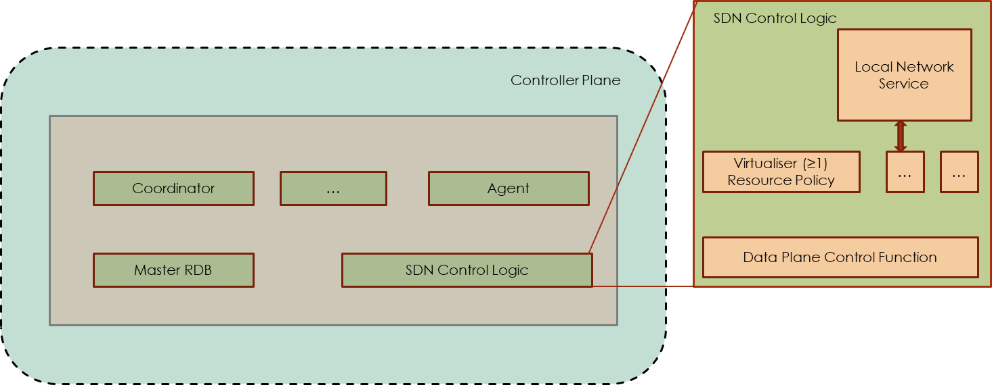
SDN Controller Functional Components
Data Plane Control Function (DPCG)
The DPCF component effectively owns the subordinate resources available to it, and uses them as instructed by the OSS/coordinator or virtualiser(s) that controls them.
These resources take the form of an information model instance accessed through the agent in the subordinate level.
The SDN controller can span multiple (virtual) NEs or even multiple virtual networks. Therefore, the DPCF must include a function that operates on the aggregate. This function is commonly called orchestration.

Slide 19
SDN Controller Functional Components
Data Plane Control Function (DPCG)
The DPCF component effectively owns the subordinate resources available to it, and uses them as instructed by the OSS/coordinator or virtualiser(s) that controls them.
These resources take the form of an information model instance accessed through the agent in the subordinate level.
The SDN controller can span multiple (virtual) NEs or even multiple virtual networks. Therefore, the DPCF must include a function that operates on the aggregate. This function is commonly called orchestration.

Slide 20
SDN Controller Functional Components
Coordinator
To set up both client and server environments, management functionality is required.
The coordinator is the functional component of the SDN controller that acts on behalf of the manager.
Clients and servers require management, throughout all perspectives on data, control and application plane models, so coordinator functional blocks are ubiquitous.

Slide 21
SDN Controller Functional Components
Agent
Any protocol must terminate in some kind of functional entity.
A controller-agent model is appropriate for the relation between a controlled and a controlling entity, and applies recursively to the SDN architecture.
The controlled entity is designated the agent, a functional component that represents the client’s resources and capabilities in the server’s environment.

Slide 22
SDN Controller Functional Components
Agent
An agent in a given SDN controller at level N represents the resources and actions available to a client or application of the SDN controller, at level N+1.
An agent in the level N-1 data plane represents the resources and actions available to the given level N SDN controller.
Even though the agent’s physical location is inside the server’s trust domain (i.e., on a server SDN controller platform), the agent notionally resides in the client’s trust domain.

Slide 23
SDN Controller Functional Components
Virtualiser
An SDN controller offers services to applications by way of an information model instance that is derived from the underlying resources, management-installed policy, and local or externally available support functions.
Virtualiser is the functional entity that supports the information model instance and policy at an A-CPI (application-controller plane interface).
It presents the local trust domain boundary to the corresponding agent, which represents the client’s view of the information model instance.

Slide 24

SDN Controller Functional Components
Virtualiser
An SDN controller offers services to applications by way of an information model instance that is derived from the underlying resources, management-installed policy, and local or externally available support functions.
Virtualiser is the functional entity that supports the information model instance and policy at an A-CPI (application-controller plane interface).
It presents the local trust domain boundary to the corresponding agent, which represents the client’s view of the information model instance.

Slide 25
SDN Controller Functional Components
Virtualiser
An SDN controller offers services to applications by way of an information model instance that is derived from the underlying resources, management-installed policy, and local or externally available support functions.
Virtualiser is the functional entity that supports the information model instance and policy at an A-CPI (application-controller plane interface).
It presents the local trust domain boundary to the corresponding agent, which represents the client’s view of the information model instance.

Slide 26
SDN Controller Functional Components
Virtualiser
The virtualiser may be thought of as the process that receives client-specific requests across the A-CPI, validates the requests against the policy and resources assigned to the client, translates the request into terms of the underlying resources, and passes the results on to the DPCF and the D-CPI.
Virtualiser and DPCF and possibly other SDN controller functions must collaborate to provide features such as notification interpretation, resource sharing, implicit provider services, and transactional integrity.
Notes:
A virtualiser is instantiated by the OSS/coordinator for each client application or organization. The OSS/coordinator allocates resources used by the virtualiser for the A-CPI view that it exposes to its application client, and it installs policy to be enforced by the virtualiser. The effect of these operations is the creation of an agent for the given client.

Slide 27
Functions of SDN Controller
Activities of the SDN Controller include:
Packet processing
Distribution
Device manager
OS components
Routing processing
OpenFlow
Interface management
Topology manager

Slide 28
Application Plane
Application Plane
Security
TE
MPLS
Routing
QoS
Others
Northbound APIs
Control Plane
Network Operating System (NOS)
Southbound APIs
Data Plane
Packet Forwarding
Packet Forwarding
Packet Forwarding

Slide 29
Application Plane
SDN Application Entity Roles:
An application plane entity may act as an information model server, in which case, it exposes an information model instance for use by other applications.
Formally, the other applications are clients, which communicate to the SDN application server agent.
An application plane entity may act as an information model client, in which case it operates on an information model instance exposed by a server entity.
An application plane entity may act in both roles simultaneously.
For example, a path computation engine (PCE) may rely on an SDN controller for virtual network topology information (maintained in a traffic engineering database), while offering the SDN controller a path computation service.

Slide 30
Application Plane
SDN Application Entity Roles:
An application plane entity may act as an information model server, in which case, it exposes an information model instance for use by other applications. Formally, the other applications are clients, which communicate to the SDN application server agent.
An application plane entity may act as an information model client, in which case it operates on an information model instance exposed by a server entity.
An application plane entity may act in both roles simultaneously. For example, a path computation engine (PCE) may rely on an SDN controller for virtual network topology information (maintained in a traffic engineering database), while offering the SDN controller a path computation service.

Slide 31
Application Plane
SDN Application Entity Roles:
An application plane entity may act as an information model server, in which case, it exposes an information model instance for use by other applications. Formally, the other applications are clients, which communicate to the SDN application server agent.
An application plane entity may act as an information model client, in which case it operates on an information model instance exposed by a server entity.
An application plane entity may act in both roles simultaneously. For example, a path computation engine (PCE) may rely on an SDN controller for virtual network topology information (maintained in a traffic engineering database), while offering the SDN controller a path computation service.

Slide 32
Application Plane
The application plane of an SDN consists of the SDN Application;
SDN Applications specify the resources and behavior required from the network, within the context of a business and policy agreement.
Application Plane
SDN Application
SDN Application

Slide 33
Application Plane
An SDN application may invoke other external services, and may orchestrate any number of SDN controllers to achieve its objectives.
Application Plane
SDN Application
SDN Application
Coordinator
A-CPI Agent (≥1)
SDN Application
SDN Application Logic

Slide 34
Management
Another plane of the SDN architecture is its management.
Management covers infrastructure support tasks that are not to be done by the application, controller and data planes themselves.
Management may also perform operations that the application, controller- and data planes are restricted from doing by policy or for other reasons.
The most important reason to prevent a task from being executed by SDN components is that the SDN controller may reside in a customer trust domain, while business reasons mandate that core management and support functions be done within the provider trust domain.
Notes:
Although an agent policy could be devised that completely trusted its controller, the transparency policy and policy enforcement software would nonetheless have to be installed by the provider’s manager. For security reasons, the default behavior is recommended to be to expose nothing, rather than everything.

Slide 35
Management
The SDN architecture recognizes classical management functions such as:
Equipment inventory
Fault isolation
Software upgrade
Recording and expressing business relationships (policies) between provider and client.
Configuring SDN entity environment and initialization parameters.
Notes:
One of the perceived benefits of SDN is allowing clients (in foreign trust domains) to perform many of the actions that are today performed by management systems. The traditional OSS interface is expected to play a smaller role over the course of time, as customer applications take on more responsibility via SDN controllers.
The management function includes coordinating data plane handoff points, identification conventions, reachability and credentials among logical and physical entities. The SDN architecture requires that this information be configured into the relevant SDN NEs, controllers, and applications, but does not specify the nature or structure of the OSSs.
In the general case, each client-server pair of data plane, controller and application level entities lies in a separate trust domain. Where a trust boundary exists in the SDN hierarchy, a corresponding trust boundary also exists in the management domain.

Slide 36
SDN Management Responsibilities
Two management roles are recognized:
Server manager
Client manager.
The responsibilities of the server manager are not the same as those of the client manager.
However, the both roles have some things in common. This include configuration of separate entities such that they can communicate with each other. This may include information such as:
Identity
Protocol selection
Reachability
Security policy and credentials.
Notes:
A manager itself may be a business or operations support system (BSS/OSS), a network management system (NMS), or even an element management system (EMS).

Slide 37
Responsibilities of the Server Manager
Instantiation of an agent in the server environment, representing a client-specific environment in a real or virtual infrastructure.
Updating client-specific resource allocation and policy over the course of time.
Auditing the compliance of resource allocations and policies to the business commitments.
Subscribing to notifications and collecting statistics for purposes of SLA monitoring, security monitoring, fault management, billing, network planning, and others.
Notes:
Instantiation of an agent in the server environment, representing a client-specific environment in a real or virtual infrastructure. This includes resource allocation and policy installation, and possibly downloading of custom or special feature modules. Client-specific configuration could include a choice of protocol or release level. SDN control of the server’s own interest is accommodated by an agent in the server’s trust domain.
Updating client-specific resource allocation and policy over the course of time. This may result from events such as business renegotiation or network build out, or from the request and release of resources covered by contract but delivered and billed on demand. A special case is the deletion of everything related to a given client when the business agreement terminates.
Auditing the compliance of resource allocations and policies to the business commitments. This includes confirming that resources are not double-booked and that the traffic of separate clients is mutually isolated. Tools for this purpose include notifications, for example of security alarms or connectivity faults.
Subscribing to notifications and collecting statistics for purposes of SLA monitoring, security monitoring, fault management, billing, network planning, and others. These are existing functions that are expected to remain unchanged except perhaps in their details.

Slide 38
Responsibilities of the Client Manager
The client manager has much the same responsibility as the server manager, but from the inverse perspective.
The client SDN controller (or application) may require information that cannot be discovered from the server, in particular about data plane adjacencies on its external network ports. If so, the manager must supply the information.
This could facilitate reconciliation or audit by the client SDN controller. Auditing of expected versus discovered resources and actions may be an important security feature.
The client manager may poll for performance or state information, or subscribe to run-time exception and performance monitoring notifications from its agent on the server controller to help with this assessment.
Notes:
The client manager has much the same responsibility as the server manager, but from the inverse perspective:
The client SDN controller (or application) may require information that cannot be discovered from the server, in particular about data plane adjacencies on its external network ports. If so, the manager must supply the information.
Although the client SDN controller receives a view of the resources from its agent on the server, the client manager may wish to instantiate its own view of the contracted resources and policy. This could facilitate reconciliation or audit by the client SDN controller. Auditing of expected versus discovered resources and actions may be an important security feature.
Both before and during operation, the server manager seeks assurance that the client gets no more service than contractually specified, while the client manager seeks assurance that it gets no less service than contractually specified. The client manager may poll for performance or state information, or subscribe to run-time exception and performance monitoring notifications from its agent on the server controller to help with this assessment.

Slide 39
SDN Architecture
Data Plane
Packet Forwarding
Packet Forwarding
Packet Forwarding

Slide 40
SDN Architecture
Northbound APIs
Control Plane
Network Operating System (NOS)
Southbound APIs
Data Plane
Packet Forwarding
Packet Forwarding
Packet Forwarding

Slide 41
SDN Architecture
Application Plane
Security
TE
MPLS
Routing
QoS
Others
Northbound APIs
Control Plane
Network Operating System (NOS)
Southbound APIs
Data Plane
Packet Forwarding
Packet Forwarding
Packet Forwarding

Slide 42
Questions!!!

